Slide 1

PRINCIPLES OF MANAGEMENT & PROFESSIONAL ETHICS
SUBJECT CODE - SBA1101
UNIT – V
PROFESSIONAL ETHICS

Slide 2
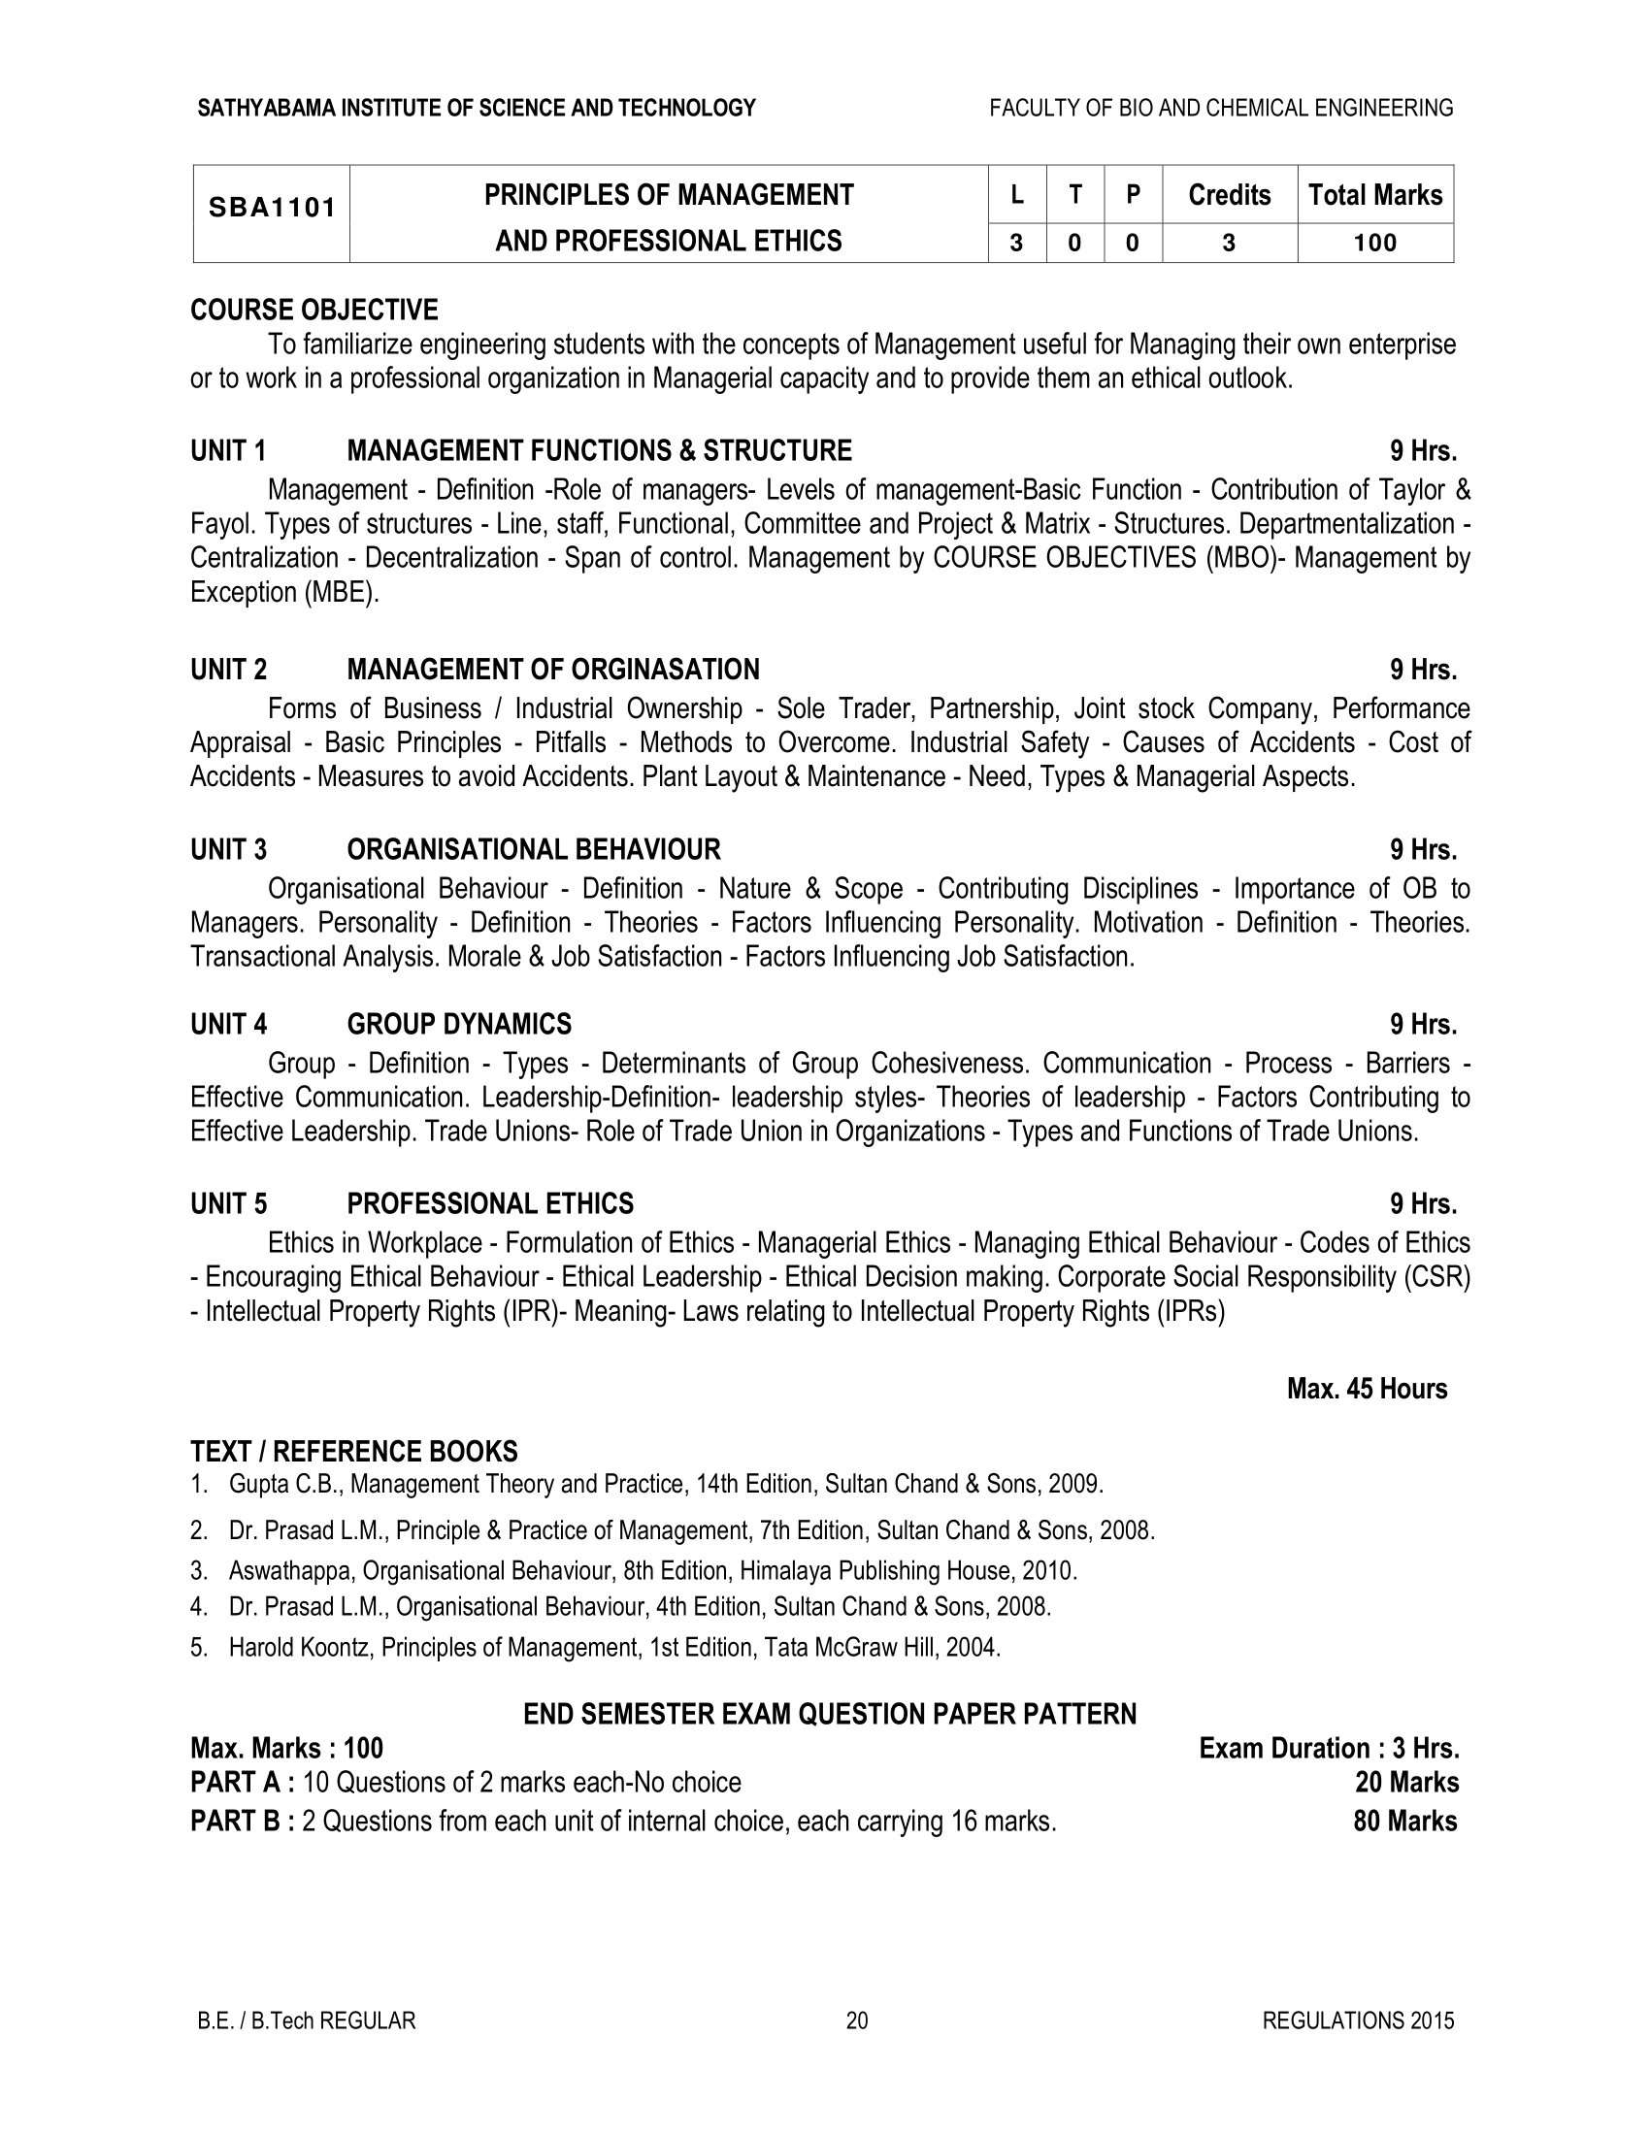

Slide 3

Ethics
"Ethics has to do with what my feelings tell me is right or wrong.“
"Ethics consists of the standards of behavior our society accepts.”

Slide 4
Ethics - Definition
Ethics is a set of principles or standards of human conduct that govern the behavior of individuals or organizations. Using these ethical standards, a person or a group of persons or an organization regulate their behavior to distinguish between what is right and what is wrong as perceived by others.
Ethics can be defined as the discipline dealing with moral duties and obligation, and explaining what is good or not good for others and for us.

Slide 5
Difference between Ethics and Morals
 | Ethics | Morals
Meaning | Ethics are guiding principles which help the individual or group to decide what is good or bad | Morals are the beliefs of the individual or group as to what is right or wrong
What is it? | General Principles set by group | Response to a specific situation
Root Word | “Ethos” which means character | “Mos” which means custom
Source | Social System / External | Individual / Internal
Examples | Honesty Responsibility Loyalty Respect | Do not cheat others Be loyal Always tell the truth

Slide 6
Ethics, Moral and Values
Ethics are rules that help us to know the difference between right or wrong. They encourage us to do the right thing.
Values tell us what is important. They help us to make decisions about right and wrong.
Morals are rules we use to decide what is good or bad.

Slide 7
Sources
The various sources from where ethical values have been evolved. The main sources are
Religion
Society
Legal System
Genetic inheritance
Nature
Culture

Slide 8
Principles of Ethics
Honesty
Promise Keeping and Trustworthiness
Loyalty
Fairness
Concern for Others
Respect for Others

Slide 9
Scope of Ethics
Ethics in Obedience
Obedience is about obeying and following to rules and authority. The motivation for being compliant could be to do the right thing out of the fear of being caught rather than a desire to be abiding by the law.
Ethics in Finance
The ethical issues in finance that companies and employees are confronted with
— Misleading financial analysis.
—over billing of expenses, facilitation payments.
— Fake reimbursements

Slide 10
Scope of Ethics
Ethics in HR
Issues affecting the privacy of the employee
Discrimination issues i.e., based on age, gender, religion, disability, weight etc.,
Occupational Safety and Health
Ethics in Marketing
Misleading advertisements
Black Market

Slide 11
Scope of Ethics
Ethics in Production
Defective products
Product testing ethics
Ethical problems arising out of new technologies
Ethics in IPR
Misusing Patents
Misusing Copyrights

Slide 12
Characteristics of Business Ethics
Business ethics are based on social values, as the generally accepted norms of good or bad and ‘right’ or ‘wrong’ practices.
It is based on the social customs, traditions, standards, and attributes.
Business ethics may determine the ways and means for better and optimum business performance.
Business ethics provide basic guidelines and parameters towards most appropriate perfections in business scenario.
Business ethics is concerned basically the study of human behaviour and conducts.
Business ethics is a philosophy to determine the standards and norms to make mutual interactions and behaviour between individual and group in organisation.
Business ethics offers to establish the norms and directional approaches for making an appropriate code of conducts in business.

Slide 13
Characteristics of Business Ethics
Business ethics are based on the concepts, thoughts and standards as contributed as well as generated by Indian ethos.
Business ethics may be an ‘Art’ as well as ‘Science’ also.
Business ethics basically inspire the values, standards and norms of professionalism in business for the well-being of customers.
Business ethics is to motivate and is consistently related with the concept of service motives for the customers’ view point.
Business ethics shows the better and standpoint ways and means for most excellences in customization.
Business ethics aims to emphasize more on social responsibility of business towards society.

Slide 14
Nature of Business Ethics
Ensure legality of business activities
Customer orientation
Supplying good quality product
Price
Following rules and regulations
Employer-employee relationship
Avoiding fraud and cheating
Environmental issues
Avoiding artificial shortage
Avoiding harmful competition

Slide 15
Elements of Business ethics
A Formal Code of Conduct
Ethics Committee
Ethical Communication System
An Ethics Office with Ethical Officers
Ethics Training Programme
Monitoring

Slide 16
Work Ethics
Workplace ethics are the set of values, moral principles, and standards that need to be followed by both employers and employees in the workplace.
It is the set of rules and regulations that need to be followed by all staff of the workplace.

Slide 17
Examples of Ethical Behaviors in The Workplace
Obey The Company’s Rules & Regulation
Communicate Effectively
Develop Professional Relationships
Take Responsibility
Be Accountable
Trust
Respect Your Colleagues

Slide 18
Examples of unethical Behaviors in The Workplace
Lies
Taking Credit for Others Hard Work
Verbal Harassment/Abuse
Violence
Non-Office Related Work
Extended Breaks
Theft
Corrupt Practices

Slide 19
How to Solve Unethical Issues at the Workplace
Have Rules
Accept Feedback/Complaint
List consequences for unethical behaviors
Disciplinary Action

Slide 20
Characteristics of a Good Work Ethics
A good ethical framework can help guide your company through times of increased growth or organizational change, and decreases your firm's susceptibility to misconduct
Reliability
Dedication
Productivity
Cooperation

Slide 21
Code of Conduct
It is also known as Code of business
Code of conduct is a set of rules which is commonly written for employees of a company, which protects the business
A professional Code of Conduct is an official document that clearly defines how a company's employees should behave in the workplace on a day-to-day basis.

Slide 22
Code of Conduct
The code of conduct includes the following
Company Values
Accurate and timely disclosure in reports and documents that the company files before Government agencies, as well as in Company's other communications
Compliance of applicable laws, rules and regulations including Insider Trading Regulations
Maintaining confidentiality of Company affairs
Standards of business conduct for Company's customers, communities, suppliers, shareholders, competitors, employees
Review of the adequacy of the Code annually by the Board
No authority of waiver of the Code for anyone should be given

Slide 23
Create Code of Conduct
To create a code of ethics, an organization must define its most important
Guiding values
Formulate behavioural standards
Illustrate the application of those values to the roles and responsibilities of the persons affected
Review the existing procedures for guidance and direction as to how those values and standards are typically applied
Establish the systems and processes to ensure that the code is implemented and effective.

Slide 24
Difference between Code of Conduct and code of ethics
Code of Ethics is a document issued by the top-level management, which consist of a set of principles, designed to guide the members of the organisation to carry out business honestly and with integrity.
Code of ethics is a set of principles which influence the judgement
Code of conduct is a set of guidelines that influence employee’s actions.
Code of Conduct is a document that expresses the practices and behaviour of a person, required or restricted as a condition for becoming a member of the organisation or profession.

Slide 25
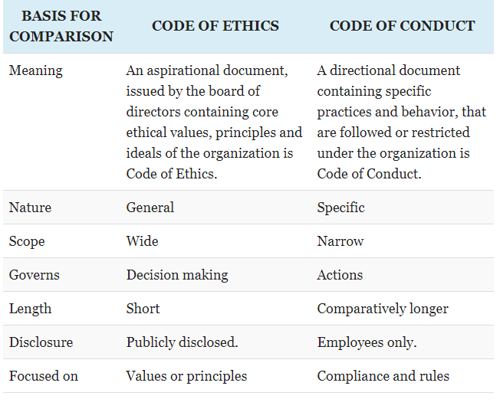
Difference between Code of Conduct and code of ethics

Slide 26
Creating code of conduct and code of ethics
Review your mission statement and core values.
Talk to stakeholders.
Review past ethical issues.
See where other companies have weakened.
Create a draft code for input and discussion.
Create a final draft and share it.

Slide 27
Advantages of having a business code of conduct
It enhances the company's core values, beliefs and sets the right culture
Helps to reach a vision and a mission to the company
Builds a reputation of the company in the market
Keeps the company and its employee's from violating laws and regulations
Creates an environment of trust and ethical behavior

Slide 28
BARRIERS OF ETHICS
Chain of command
Group membership
Confusing priorities

Slide 29
Ethical Analysis
According to Hosmer’s model
Identify the Moral Issue
Identify Additional Facts Helpful to Making a Decision
Identify the Alternatives Available to Apply to the Problem
Identify the Personal Impacts to the Decision Maker
Apply Three Leading Contemporary Theories of Business Ethics: Shareholder, Stakeholder, and Asset
Conclude With a Decision

Slide 30
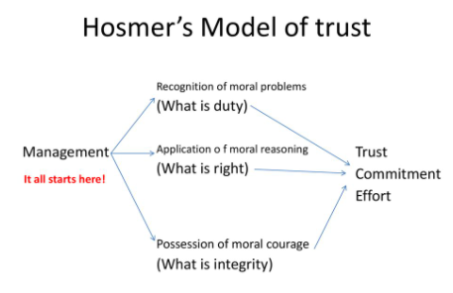
Hosmer’s Model of trust

Slide 31
Common Workplace ethics
Punctuality
Responsibility
Honesty and loyalty
Teamwork
Professionalism
Positive Attitude
Commitment to excellence
Reliability
Being Productive
Respect

Slide 32
Ethics for managers
Honesty
Integrity
Promise-Keeping & Trustworthiness
Loyalty
Fairness
Concern For Others
Respect For Others
Law Abiding

Slide 33
How to be an ethical manager
Ethical managers are those who continuously practice the following behaviors.
Remaining committed to honesty, fairness, and excellent work ethics.
Valuing employees as individuals as well as workers.
Knowing that how objectives are met is just as important as meeting objectives.
Modeling ethical behavior like not shifting blame, not playing favorites, and not trying to out do the deeds of others.
Looking out for others, and always taking their interests and needs into account.

Slide 34
Role of ethical managers
read and understand the Code
Exercise appropriate supervision and oversight to ensure compliance with the Code within your area of responsibility
Anticipate, prevent and detect compliance risks
Punctually report and address any compliance violations or weaknesses, including taking appropriate disciplinary action
Enforce the Code and related policies and procedures consistently
Support your employees who, in good faith, raise issues or concerns
Ensure that none of your employees are get revenge against for making reports

Slide 35
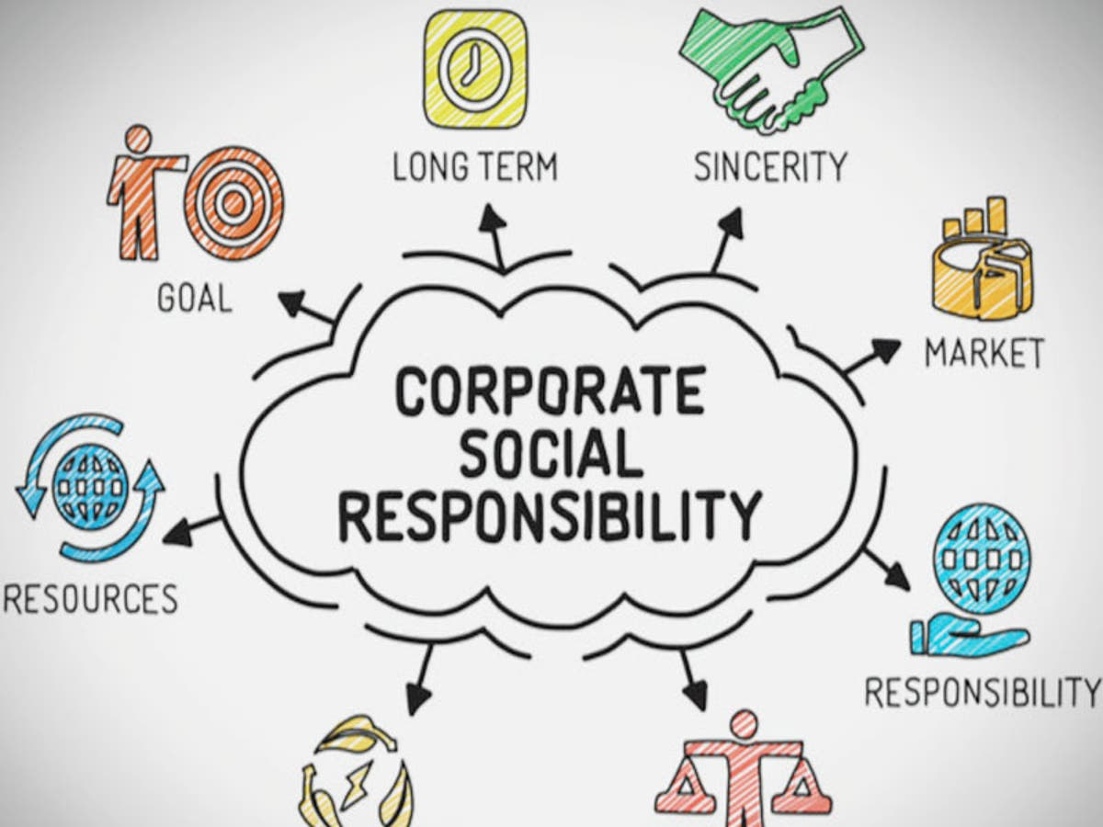

Slide 36
Corporate Social Responsibility
Corporate social responsibility is a gesture of showing the company’s concern & commitment towards society’s sustainability & development
CSR is the ethical behavior of a company towards society.

Slide 37
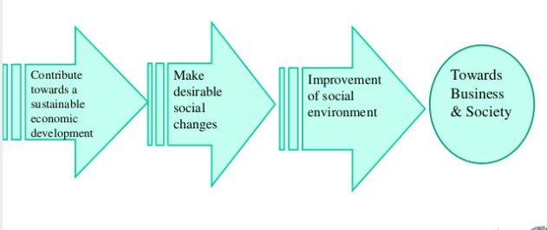
Basic Constituents of Corporate Social Responsibility

Slide 38
Social Responsibility for different interest group
Responsibility towards society
Responsibility towards government
Responsibility towards shareholders
Responsibility towards employee
Responsibility towards consumers
Responsibilities of business

Slide 39
Responsibility towards society
Carrying on business with moral & ethical standards.
Prevention of environmental pollution.
Minimizing ecological imbalance.
Contributing towards the development of social health, education
Making use of appropriate technology.
Overall development of locality.
To be pollution free and maintain ecological balance.
To invest more in research and development so as to improve the standard of living of the society.
To develop alternative recourses thereby preventing current resources being used from exhaustion.
To include in social welfare activities

Slide 40
Responsibility towards government
Obey rules & regulations.
Regular payment of taxes.
Cooperating with the Govt to promote social values.
Not to take advantage of loop holes in business laws.
Cooperating with the Govt for economic growth & development.

Slide 41
Responsibility towards shareholder
To ensure a reasonable rate of return over time.
To work for the survival & the growth of the concern.
To build reputation & goodwill of the company.
To make the shareholders feel secured by protecting their investments
To be transparent
To allow them to participate in decision making
To ensure them good dividends

Slide 42
Responsibility Towards employee
To provide a healthy working environment.
To grant regular & fair wages.
To provide welfare services.
To provide training & promotion facilities.
To provide reasonable working standard & norms.
To provide efficient mechanism to redress worker’s grievances.
To educate the employees by adopting proper training methods.
To recognize and appreciate the work of the employees and reward them or to promote them.
To enable them to involve in decision making.

Slide 43
Responsibility towards consumer
Supplying socially harmless products.
Supplying the quality, standards, as promised.
Adopt fair pricing.
Resisting black-marketing.
Maintaining consumer’s grievances cell.
Fair competition.
To improve the efficiency of the business by
Increasing productivity.
Improving quality.
improving distribution system.
To provide pre-purchase and post purchase service to the consumers.
To facilitate research and development to meet the customer requirements.
To maximize perfections in distribution systems.
To provide sufficient and necessary information about the product.

Slide 44
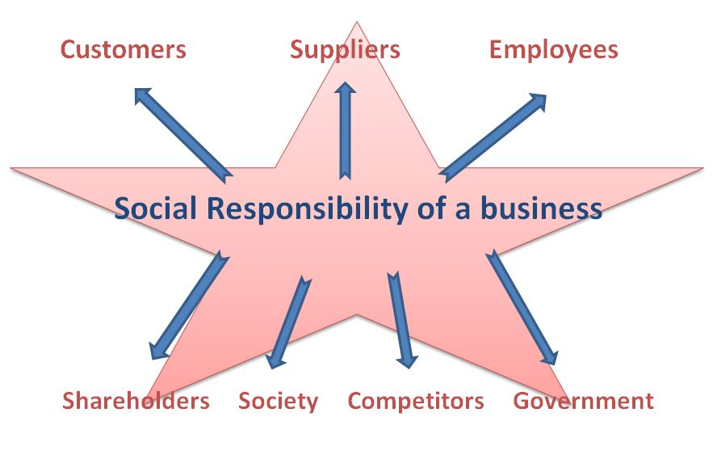
SOCIAL RESPONSIBILITIES OF BUSINESS
A firm expresses its responsibility to the business by reacting the following two ways.
1. The manner in which it carries out its own business activities
2. The welfare activities it takes upon itself as an additional function

Slide 45
ITC CSR Activities
ITC's Social Investment Initiatives
Afforestation Programme.
Watershed Development Programme.
Sustainable Agriculture.
Livestock Development.
Women Empowerment.
Primary Education.
Skilling & Vocational Training.

Slide 46
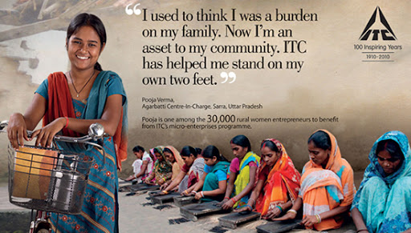
ITC CSR Activities

Slide 47
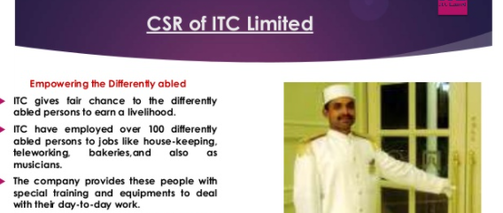
ITC CSR Activities

Slide 48
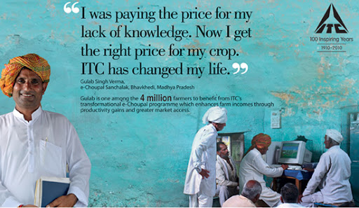
ITC CSR Activities

Slide 49
Need for CSR
Issues such as environmental damage, improper treatment of workers, and faulty production leading to customer inconvenience or danger are being highlighted.
Investors and investment fund managers have began to take account of a firm’s CSR policy in making investment decisions.
Some consumers have become increasingly sensitive to the CSR program of the firms from which they buy their goods and services.

Slide 50
Need for CSR for consumers and society
Important for encouraging businesses
Consumer preference
Consumer opinions
Issues mainly emphasized on by consumers:
Product quality
Money value
Leads to increase in the awareness of the society
Helps in dealing with societal matters such as:
Nutrition & health issues
Human rights & gender
Labor practices
Involvement in community issues

Slide 51
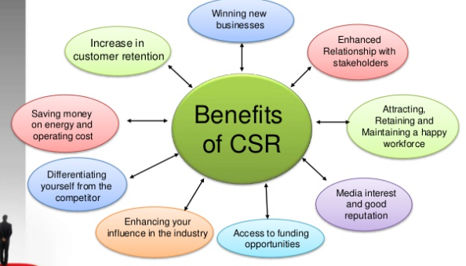
Benefits of CSR

Slide 52
Evolution of CSR in India
Phase – 1 : In the pre Industrialization period, the main drivers of Charity were
Charity
The wealthy merchants shared their wealth by building temples, providing food during famines, etc. But with the arrival of colonial rule, the approach changed & the industrial families became strongly inclined towards economic & social considerations.
Phase – 2 : During the Independence period, Mahatma Gandhi introduced the notion of trusteeship.
Under his influence businesses established trusts for schools and colleges and also helped in setting up training and scientific institutions.
All these were in line with Gandhi’s reforms to abolish untouchability, women empowerment & rural development.

Slide 53
Evolution of CSR in India
Phase – 3 : CSR was influenced by the emergence of Public sector undertakings to ensure proper distribution of wealth.
The policy of industrial licensing, high taxes and restrictions on the private sector resulted in corporate malpractices.
Therefore there was a natural shift of expectation from the public to the private sector and their active involvement in the socio-economic growth.
Phase – 4 : Indian companies integrated CSR into a sustainable business strategy.
With partial withdrawal of controls and licensing systems there was a boom in the economic growth of the country.
This led to the increased momentum in industrial growth, making it possible for the companies to contribute more towards social responsibility

Slide 54
Advantages of CSR
It improves value and profitability
It enhances organisation’s reputation
It assist to bring motivation among the employees

Slide 55
Disadvantages of CSR
It needs higher costs and expenses
It can increase investor’s opposition
It promotes Greenwashing
Voluntary initiatives only

Slide 56
Criteria for determining the social responsibility of business
Realisation of social responsibilities
Profit Motive
Long-term interests of the business
Greater social power,
Larger the size, greater shall be the social responsibilities
Social responsibility vary with the type of the company
Attracting investment
Internalize more of its external costs

Slide 57
Types of Social Responsibility
Economic Responsibility
Every business is engaged in economic activities.
So, the prime social responsibility of every business should be economic responsibility.
Hence they should sell products and service which can satisfy the need of the society.
Legal Responsibility
The company should comply with the political and legal environment of the country.
The company should consider protecting the environment.
Ethical Responsibility
This type of responsibility expects a certain type of behaviour or conduct from the company.
This behaviour may not be documented by law.
Discretionary Responsibility
These are voluntary actions taken by the entities in case of natural calamities, helping poor people etc.
They help them by providing a charitable contribution, education activities etc.
It prevents investments of charitable funds into speculative activities.

Slide 58
Voluntary Responsibility vs Law Requirement
The voluntary approach to CSR implies that corporations may or may not apply CSR practices in their activities as result of a lack of enforceability of CSR standards, which in turn implies that corporations have a high degree of flexibility in the way they wish to conduct their businesses.

Slide 59
Voluntary Responsibility vs Law Requirement
It's not just a regulation to promote or help companies who want to be socially responsible. It's a law that decrees that companies should dedicate a 2% of their net profits to CSR activities. In India, mandatory CSR is a solution to reach places that the State cannot reach on its own.
Five years after the Companies Act, 2013 made it mandatory for companies above a certain size and profitability to contribute a percentage of their profits to social development, talk of corporate social responsibility, or CSR, is everywhere.

Slide 60
Voluntary Responsibility vs Law Requirement
The Companies Act, 2013, a successor to The Companies Act, 1956, made CSR a compulsory act. Under the notification dated 27.2.2014, under Section 135 of the new act, CSR is compulsory for all companies- government or private or otherwise, provided they meet any one or more of the following fiscal criterions:
The net worth of the company should be Rupees 500 crores or more
The annual turnover of the company should be Rupees 1000 crores or more
Annual net profits of the company should be at least Rupees 5 crores.
If the company meets any one of the three fiscal conditions as stated above, they are required to create a committee to enforce its CSR mandate, with at least 3 directors, one of whom should be an independent director.

Slide 61
Voluntary Responsibility vs Law Requirement
The responsibilities of the committee will be
Creation of an elaborate policy to implement its legally mandated CSR activities. CSR acts should conform to Schedule VII of the Companies Act, 2013.
The committee will allocate and audit the money for different CSR purposes.
It will be responsible for overseeing the execution of different CSR activities.
The committee will issue an annual report on the various CSR activities undertaken.
CSR policies should be placed on the company’s official website, in the form and format approved by the committee.
The board of directors is bound to accept and follow any CSR related suggestion put up by the aforementioned committee.
The aforementioned committee must regularly assess the net profits earned by the company and ensure that at least 2 percent of the same is spent on CSR related activities.
The committee must ensure that local issues and regions are looked into first as part of CSR activities.

Slide 62
Features of CSR Laws
The broad and important features of the CSR laws are as follows:
Quantum of money utilized for CSR purposes are to be compulsorily included in the annual profit-loss report released by the company.
The CSR rules came into force on 1st April 2014 and will include subsidiary companies, holdings and other foreign corporate organizations which are involved in business activities in India.
CSR has been defined in a rather broad manner in Schedule VII of Companies Act, 2013. The definition is exhaustive as it includes those specific CSR activities listed in Schedule VII and other social programmes not listed in schedule VII, whose inclusion as a CSR activity is left to the company’s discretion

Slide 63
Profit Maximization vs Social Responsibility
Being a socially responsible business is a concept that includes a variety of options, including helping advance a cause or profession, donating time, reducing environmental impacts, pursuing more diversified hiring or making monetary donations.
Some capitalists believe that their existence is enough of a social contribution because they create jobs and provide tax money for municipalities and state and local governments.
The more profits they generate, the more they benefit society. Some entrepreneurs feel they can better help advance causes than a government bureaucracy can.
Other business owners limit their social activities to reducing waste, pollution and other environmental problems their business might cause.
Obligation to Financial Stakeholders
Return on Investment
Internal Behaviors

Slide 64

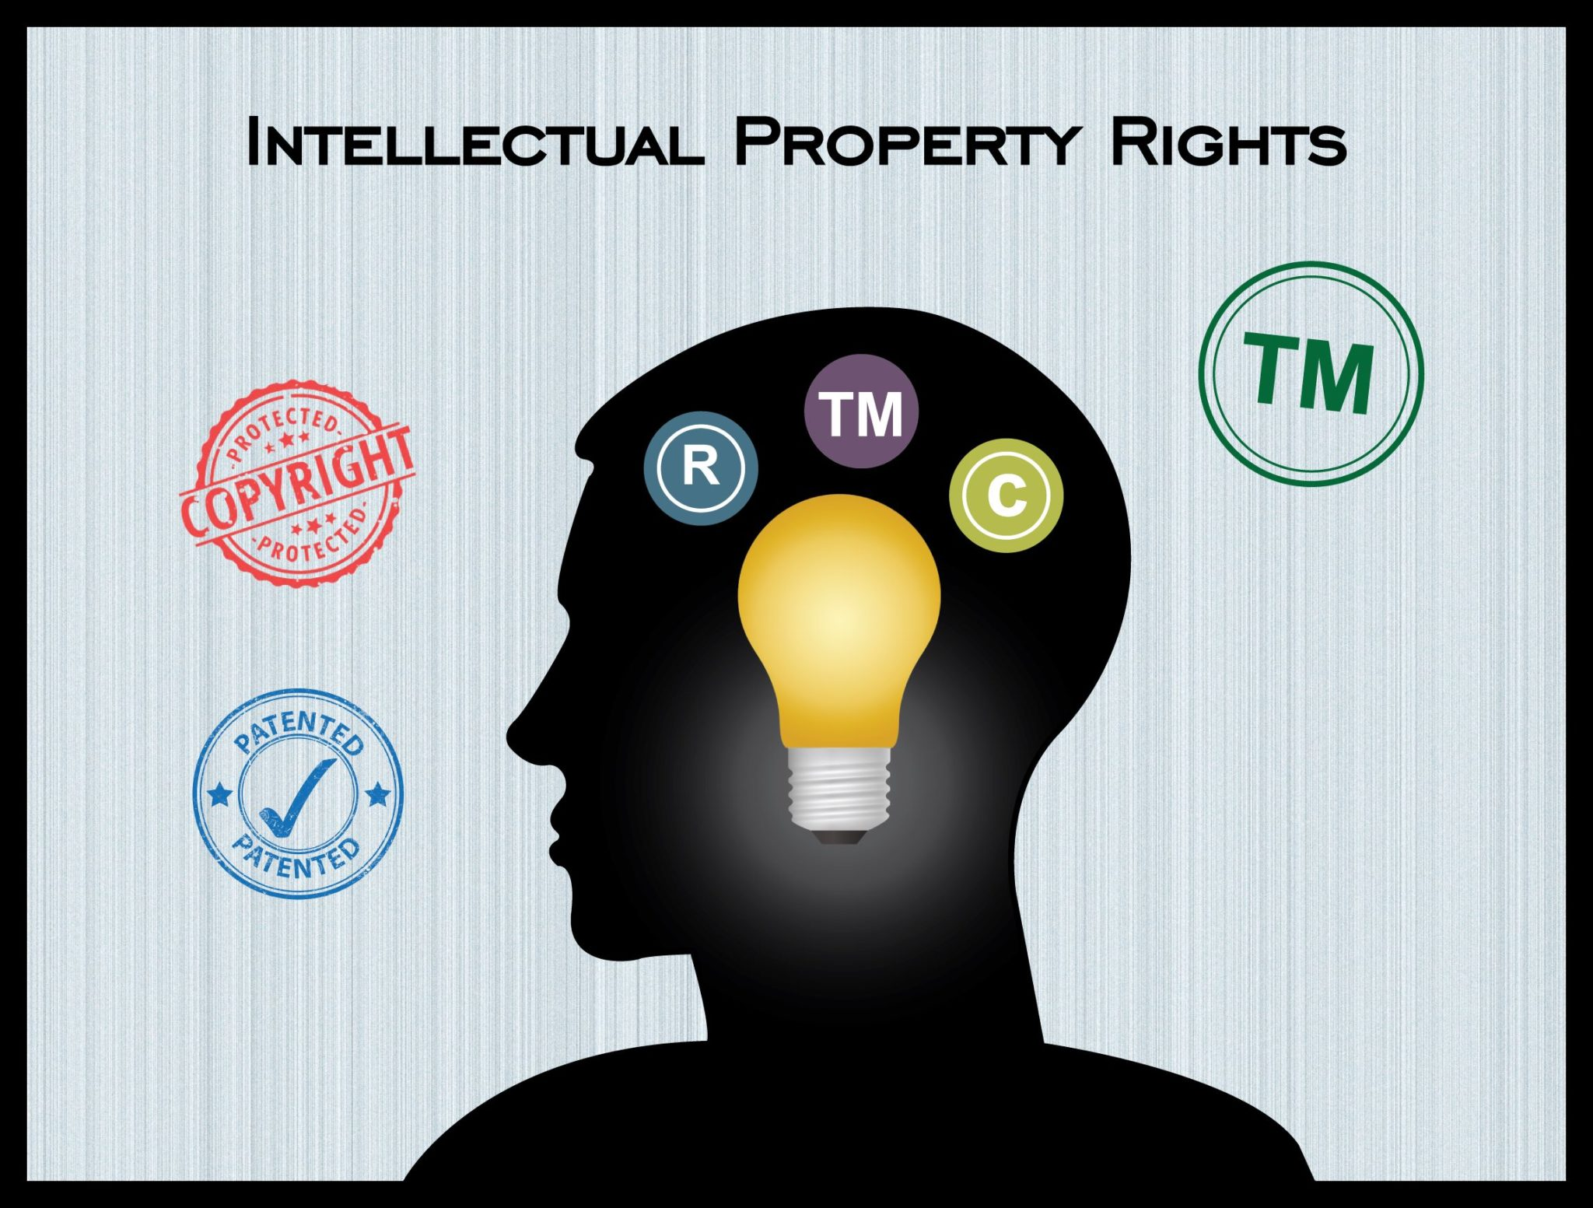


Slide 65

What is meant by IPRs?
Intellectual Property (IP) is any creations of human mind.
Intellectual Property Rights (IPR) gives them this protection,
as well as helping them exploit and control their IP.
“The exclusive right granted by State, to prevent others from using, manufacturing, distributing - inventions, processes, applications, new and original designs, trademarks, new plant varieties, data bases and artistic and literary works”.
Such a person is known as ‘rights owner’ or ‘rights holder’.

Slide 66
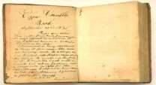

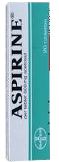



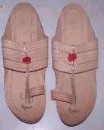
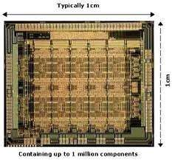


TYPES OF IPRs:
4
Industrial Property
Copyrights and related rights
Industrial designs
Geographical indication
Layout Designs of semiconductor ICs
Plant varieties & Farmer’s rights
patent
Trademarks
Trade Secrets
p

Slide 67
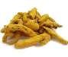

IPR in brief
Industrial Designs: Design deals with features, shapes, patterns, etc., applied to an article by an industrial process, manual or mechanical. Eg., chair is a utility item. However, chair itself does not qualify for IPR, but its special carvings, embossing etc., is done which increases the value of chair though it’s utility remains same, it becomes eligible for IPR under Designs Act. Designs can be registered based on its originality, henceforth they can use ® or registered, with registration number.
Patents: Is a monopoly right granted to a person, who invented a new product or process of making an article, for 20years under the Indian Patens Act, 1970, and can be renewed after expiration of period. The inventor has to file for patent first, and then make his/ her invention to public. A patent has to be applied in each country by the inventor, to claim his rights in that country. Eg: A group of scientists working on new drug development in Himalaya Drugs for some salary. The patent of the drug developed is given to Himalaya Drugs, but not to the scientists. The drug may have many patents like composition, process, and product etc.
Trademarks: Trademark can be a word, name, brand, symbol, label etc., used by a company to create a unique identity for their product. Trademark can be registered, and then use ™ ®. The registration validity is for 7 years and renewable after expiry. In India, it is governed by the Trade and Merchandise Marks Act, 1958, which came into force on 25th Nov., 1959.
•
•

Slide 68
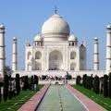

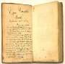
IPR in brief..
Trade Secrets: Trade secret is any intellectual work or product used for a business purpose that can be classified as belonging to that business provided it is not based on information in public domain.
Geographical Indication: This is an indication, that originates from a definite geographical area, which is used to identify natural or manufactured product. For eg.,Nirmal paintings, Kolhapuri Chappals, etc., qualify for registration under this category. It is valid for 10 years.
Copyright: It is a right which prevents the appropriation of the fruits of man’s work, labour or skill by another person. Copyright is an exclusive legal right to reproduce an original work of authorship fixed in any tangible medium of expression, to prepare derivative works based on original work, and to perform or display the work in the case of dramatic, music, choreographic and sculptural works.
Eg: Bhagwat Geeta, Pathanjali Yoga sutras
•

Slide 69
1. INDUSTRIAL DESIGNS:
6
Design deals with features, shapes, patterns, etc., applied to an article by an industrial process, manual or mechanical.
Eg., chair is a utility item. However, chair itself does not qualify for IPR, but its special carvings, embossing etc., is done which increases the value of chair though it’s utility remains same, it becomes eligible for IPR under Designs Act.
Designs can be registered based on its originality, henceforth they can use ® or registered, with registration number.

Slide 70
The laws governing designs are the Designs Act of 2000 and the Designs Rules of 2001. In India designs are defined as ⁷ follows:
‘A design refers to the features of shape, configuration, pattern, ornamentation or composition of lines or colors applied to any article, in two or three dimensional (or both) forms’. (Design Office, Kolkata: Guidelines for Registration)
Designs are valid for a maximum of ten years, renewable for a further five years.

Slide 71
2.TRADE MARKS :
8
Trade Marks Act, 1999 defines TM as a mark capable of being represented graphically and which is capable of distinguishing the goods or services of one person from those of others and may include shape of goods, their packaging and combination of colours.
Mark includes “Device, brand, heading, label, ticket, name, signature, word, letter, numeral, shape of goods, packaging, combination of colours, and any combination thereof.”
Brand refers to a name, term, sign, symbol, or design, or a combination of them, intended to identify the goods or services of one seller or group of sellers and to differentiate them from those of competitors. E.g. McDonald for restaurants, Cycle brand agarbattis, etc.

Slide 72
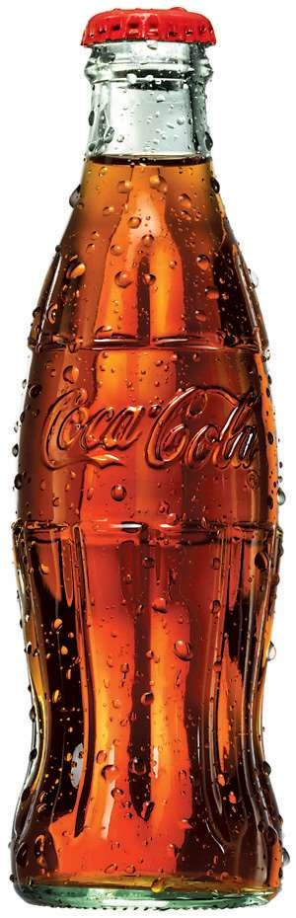


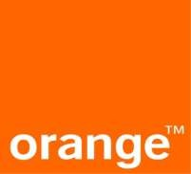
10
Name
Logotype Symbol Slogan Shape Color

Slide 73
Brand Name is that part of a brand which can be vocalized-the ₉
utterable.
Brand Mark is that part of a brand which can be recognised but is not a utterable, such as symbol, design or distinctive colouring or lettering.
Device refers to pictorial representations – e.g. animals, birds, landscape buildings, etc.
Letter as a mark is the identity created out of letterforms and has its inbuilt strength of distinctiveness and individuality – e.g. IBM, GM, ELBEE,

Slide 74
TRADE MARKS TERMS EXPLANATION
Numerals can be registered as trade mark upon evidence of user, e.g. 555, 501
Symbols may take the shape of brand or logos. A logo is a visual depiction of a manufacturer or company and gives an identity to it. E.g. B.M.W., Maruti, Benz etc.
Label and ticket mean a composite mark containing various features incl. devices, words, usually painted on paper and attached to the goods themselves.
Name is the words signifying a name, surname or a personal name or an
abbreviation thereof
Color – a combination of colors can be considered as a trademark-e.g. color combinations used in drug capsules.
Sound – sound or a sequence of sound can be registered as a trade mark –
e.g. ‘the roar of the lion’ sound has been registered by MGM pictures
Smell – Registration of smell as a trademark has been permitted as a trade mark. A smell reminiscent of roses applied to tyres was registered for Sumitomo tyres – smell of fresh cut grass for the tennis ball, etc.
Containers fall within the definition of trade mark.

Slide 75
TRADE MARKS TERMS EXPLANATION.
‘Collective mark’ means a trade mark distinguishing the goods or services of members of an association of persons (not being a partnership), who is the proprietor of the mark from those of others.
‘Service’ means service of any description which is made available to potential users and includes the provisions of services in connection with business of any industrial or commercial matters such as banking, communication, education, financing, insurance, chit funds, real estate, transport, storage, material treatment, processing, supply of electrical or other energy, boarding, lodging, entertainment, construction, repair, conveying of news or information and advertising. A mark identifying such a service is called a service mark.
“Certification trade mark” means a mark capable of distinguishing the goods or services in connection with which it is used in the course of trade which are certified by the proprietor of the mark in respect of origin, material, mode of manufacture of goods or performance of services, quality, accuracy or other characteristics from goods and services not so certified. (e.g. wool mark, ISO 9001 etc.)

Slide 76
TRADE MARKS REGISTRATION
Trademark and Service mark are used before registration.
Registration of a trade mark is not a compulsory requirement of the law. The Controller-General of Patents, Designs and Trade Marks Act, appointed by the central government is the Registrar of Trade Marks. A Register of Trade Marks shall be kept in offices, Regd. Trade Marks details shall be entered into the register.
Once Trade Mark is accepted, allotted should advertise it in prescribed manner.
The registration of a trade mark, if valid, gives its proprietor the exclusive right to the use of the trade mark in relation to the goods or services in respect of which the trade mark is registered and to obtain relief in respect of infringement of the trade mark.
A trademark registration is for 10 years from the date of registration and can be renewed every 10 years consecutively. Failure to renew is removal of the trade mark from register.

Slide 77
REFUSAL GROUNDS FOR REGISTRATION
Grounds for refusal of registration
Descriptive marks
Generic marks
Marks of such a nature as to cause confusion
Marks containing any matter which is likely to hurt the religious susceptibilities of any class or section of the Indian citizens
Marks containing improper matter
Marks prohibited under the Emblems and Names (Prevention of Improper use) Act, 1950
similar to earlier trademark and identical or similar goods and services.

Slide 78
TRADEMARK REGISTRATION..
If the earlier trademark being a well-known trademark and the trademark sought to be registered is identical with or similar to an earlier trademark and the goods or services are dissimilar and the use of the mark would take unfair advantage of or be detrimental to the distinctive character or repute of the earlier trade mark.
If the use of trademark in India is liable to be prevented because of any law protecting an unregistered trademark used in the course of trade or because of law of copy right.
Acquisition of Trademark
Trademark may be acquired either by the proprietor of the goods and services for which trademark is sought for registration or by transfer, license, lease, assignment by the proprietor to another entity.
Suit for violation
Suit for violation of registered trademark or relating to any right in a registered trademark or for passing off has to be filed in a IP Appellate Board/ District Court. Reliefs can be claimed by way of injunction, damages, account of profits with or without an order for the delivery up of the violation labels and marks for destruction or erasure.

Slide 79

Trademarks & Service Marks

Slide 80

Trademark Infringement, Counterfeit and Dilution
Infringement - A mark that is likely to cause confusion with a trademark already existing in the marketplace
Counterfeit - The intentionally copying of a mark
Dilution - The value of the mark is substantially reduced through competition or through the likelihood of confusion from another mark

Slide 81
3. Trade Secrets:
11
Trade secret is any intellectual work or product used for a business purpose that can be classified as belonging to that business provided it is not based on information in public domain.
A trade secret consists of
a formula, device, idea, process, pattern, or compilation of information that gives the owner a competitive advantage in the marketplace,
a novel idea that is not common knowledge and is kept in a confidential state.

Slide 82
12
A trade secret is not protected by federal law
Can only be protected through employment contracts and/or maintaining tight security
Recipes, ingredients, codes, manufacturing costs etc.

Slide 83

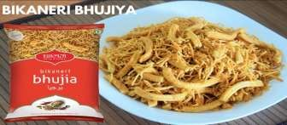
4.GEOGRAPHICAL INDICATIONS:
13
This is an indication, that originates from a definite geographical area, which is used to identify natural or manufactured product.
For eg., Darjeeling Tea, Tirupati Laddu, Nagpur Orange, etc. qualify for registration under this category.
It is valid for 10 years & can be renewed from time to time for a further period of 10 years each.
The application for registration can be an association of persons, organization or by producers.

Slide 84
5.COPYRIGHT:
14
Copyright is a monopoly right restraining others from exercising that right which has been conferred on the owner of copyright.
It is a right meaning thereby that it is prohibitory in nature. It is a right to prevent others from copying or reproducing the work.

Slide 85
TERM (Period) OF COPYRIGHT
16
In the case of any literary, dramatic, musical or a artistic work (other than a photograph), life time of the author + 60 years.
In the case of photograph, cine films, sound recording and Govt. Work, 60 years from the beginning of the calendar year next following the year in which the work is first published.
In the case of broadcasters/performers, reproduction right shall subsist until 25 years from the calendar year next following the year in which the broadcast/performance is made.

Slide 86
Copyright is a bundle of rights consisting of 1) economic rights and 2) moral rights.
ECONOMIC RIGHTS:
In the case of a literary, dramatic or musical work, not being a computer program, the right consists of ,-
To reproduce the work in any material form incl. the storing of in any medium by electronic means;
to issue copies of the work to the public ;
to perform the work in public, or communicate it to the public;
to make any cinematographic film or sound recording in respect of the work;
to make any translation of the work;
to make any adaptation of the work;
to do, in relation to translation or adaptation of the work, any of the acts specified in relation to the work in sub-clauses (1) to (6)
In the case of computer program,-
to do any of the facts specified in clause (a);
to sell or give on hire, or offer for sale or hire any copy of the computer program, regardless of whether such copy has been sold or given on hire on earlier occasions;

Slide 87
in the case of an artistic work,-
to reproduce the work in any material form incl. depiction in two dimensions of a three dimensional work;
to communicate the work in public;
to issue copies of the work to the public;
to include the work in any cinematographic film;
to make adaptation of the work;
to do in relation to an adaptation of the work, any of the acts specified in relation to the work in sub-clauses (1) to (4).
in the case of cinematographic film,-
to make a copy of the film, incl. a photograph of any image forming part thereof;
to sell or give on hire, or offer for sale or hire, any copy of the film, regardless of whether such copy has been sold or given on hire on earlier occasions;
to communicate the film to the public.

Slide 88
in the case of a sound recording,-
to make any other sound recording embodying it;
to sell or give on hire, or offer for sale or hire, any copy of the sound recording regardless of whether such copy has been sold or given on hire on earlier occasions;
to communicate the sound recording to the public.
MORAL RIGHTS:
the right to decide whether to publish or not to publish the work;
the right to claim authorship of a published or exhibited work;
the right to prevent alteration and other actions that may damage the author’s
honour or reputation – the right of integrity;
to restrain or claim damages.
TERM (Period) OF COPYRIGHT
In the case of any literary, dramatic, musical or a artistic work (other than a
photograph), life time of the author + 60 years.
In the case of photograph, cine films, sound recording and Govt. Work, 60 years from the beginning of the calendar year next following the year in which the work is first published.
In the case of broadcasters/performers, reproduction right years from the calendar year next following the broadcast/performance is made.
shall subsist until 25 year in which the

Slide 89
COPYRIGHT - OWNERSHIP
AUTHOR AND OWNERSHIP OF COPYRIGHT: [See Sec. 2(d)]
The author in relation to various categories of works is as follows:-
Literary or dramatic work – author of the work
Musical work – composer
Artistic work – Artist
Photograph – Photographer
Cinematograph film – Film producer
Sound recording – the producer
Literary, dramatic, musical or artistic work which is computer generated –
the person who causes the work to be created.
The owner of copyright:
Normally the author of the work will be the first owner, subject to the following exceptions.

Slide 90
COPYRIGHT – OWNESHIP : EXCEPTIONS
Where a work is made by the author in the course of his employment by the proprietor of a newspaper/magazine/
periodical for publication therein, then such proprietor will be first
owner.
When a work is made in the course of the author’s employment under a
contract of service/apprenticeship, the employer will be the first owner.
Where any person has delivered any address or speech in public, that person will be first owner of the copyright.
In the case of Government work, government is the first owner.

Slide 91


6.PATENT:
17
A Patent is an intellectual property right relating to invention & is the grant of exclusive right,for limited period,provided by the Government to the patentee.
Is a monopoly right granted to a person, who invented a new product or process of making an article, for 20years under the Indian Patens Act, 1970, and can be renewed after expiration of period.
The inventor has to file for patent first, and then make his/ her invention to public.

Slide 92
A patent has to be applied in each country by the inventor, to claim his rights in that country.
Eg: A group of scientists working on new drug development in Himalaya Drugs for some salary. The patent of the drug developed is given to Himalaya Drugs, but not to the scientists. The drug may have many patents like composition, process, and product etc.
18

Slide 93
Types of Patents
Utility Patent: Whoever invents or discovers any new and useful process, machine, manufacture, or composition of matter, or any new and useful improvement thereof, may obtain a patent therefore, subject to the conditions and requirements of this title.
E.g:tools, machines, good for 20 years
Plant Patent: Whoever invents or discovers
and
of plant, including
reproduces any distinct and new variety
cultivated spores, mutants, hybrids, and newly found seedlings, other than a tuber propagated plant or a plant found in an uncultivated state
Eg :New Varieties of plant
Design Patent: Whoever invents any new, original, and ornamental design for an article of manufacture may obtain a patent.
E.g: decoration, jewellery

Slide 94
Patents contd..
Under the Indian Patent Law, a “Patentable invention” must be,-
a new product or process;
useful; and
capable of industrial application.
The invention, besides being new and non-obvious, must also be useful. If the invention can not be put to any beneficial use of the mankind, it can not be patented.

Slide 95
Exceptions:
Some inventions can not be patented. They include,- [see sec.3]
Inventions which are injurious to public health or violate public morality or public interest or which causes serious prejudice to human, animal or plant life or health, or to the environment;
New method of agriculture or horticulture is non-patentable
A process of treatment of human beings, animals or plants;
Inventions relating to atomic energy.
Duplication of known properties of traditionally
A presentation of information;

Slide 96
Persons entitled to apply for patent:
Person claiming to be the true and first inventor of the invention.
Any person being the assignee of the true and first inventor of the
invention
Full Disclosure of invention:
While the Act grants exclusive right to the inventor to exploit his invention for commercial gain for a specific period of time, it also imposes on him the duty of fully disclosing the invention in the complete specification so as to facilitate anyone from the public working the invention, once the period of protection is over. The full disclosure of the patented invention is mandatory. If this is not done, the patent will not be granted. The validity of such patent, even if granted, can be contested by an opposing party. The patent can be revoked on such contest succeeding.

Slide 97
Use by Central Government: Though the patentee has exclusive right of use, the Act provides for the Central Govt. to use any invention even without paying the royalty to the inventor. The Central Govt. can acquire the patent from the patentee or any other person having interest in the patent, by paying the compensation, in public interest.
Restricted use of patented invention:
Such use by a person other than the patentee is permissible. For instance, use of patented invention is permissible for research or experimental purposes or for imparting knowledge or instructions to pupils.

Slide 98

Types of Patent Applications
25
Ordinary Application
Application for Patent of Addition(granted For Improvement or
Modification of the already patented invention,for an unexpired term of the main patent).
Divisional Application(in case of Variety of inventions disclosed in the main application)
Convention application, claiming priority date on the basis of filling Convention Countries.
National Phase Application under PCT.

Slide 99


PROCEDURE TO GET PATENT
26
A patent application can be filed at only of the four patent offices in India (Kolkata, Delhi, Mumbai and Chennai).
The patent application passes through the following stages:
A.FILING
B.PUBLICATION
C.EXAMINATION
D.OPPOSITION
E. GRANT

Slide 100

A. Filing
27
1. Applicant : An application for a patent can be filed by the true and first inventor. It can also be filed the by the assignee or legal representative of the inventor.
2. Form of Application: Every application shall be accompanied by a provisional or complete specification.

Slide 101

Provisional Patent Application
28
An applicant may file a provisional specification
& general description of the
containing incomplete invention.
Objective of it is to fix the priority date
Complete specification is to be filed within 12+3 (15 months) from the date of filing provisional specification.

Slide 102

Complete Specification
29
Submission of complete specification is necessary to obtain a patent it must be submitted within 12 months of filing the provisional specification.
Contents of complete specification would include following-
Title of the invention
Field to which the invention belongs
Background of the invention including prior art giving drawbacks of the known inventions and practices

Slide 103
4) Complete description of the invention along with experimental results
30
Drawings (if necessary)
Claims, which are statements of technical facts expressed in legal terms, related to the invention on
which legal proprietorship is being sought. therefore the claims have to be drafted very carefully.

Slide 104
FORM - 2
THE PATENTS ACT, 1970
31
(39 of 1970)
COMPLETE SPECIFICATION [SECTION 10; RULE 13]
1. Title of Invention
2. (a)
Name of Applicant
Address of Applicant
Nationality: Indian.
The following specification particularly describes the nature of this invention and the manner
in which it is to be performed.

Slide 105

5 Documents to be submitted at the time of filing. The following documents have to be submitted at the time of filing a patent application:
32
Form 1 - Application for the grant of patent.
Form 2 - Provisional or Complete Specification.
Form 3 - Statement and undertaking by the applicant.
Form 5 - Declaration as to inventorship.
Form 26 - Authorization of patent agent or any other person
‘

Slide 106

B.PUBLICATION
33
A patent application will be published on expiry of eighteen months after the priority date. It can be published earlier, if such a request is made by the applicant.
On publication, specification including drawings and deposits shall be open for public inspection. The rights of the patentee start after patent grant.

Slide 107


C. Examination of Patent
34
Patent Application on method or procedure of manufacturing substance will be examined only after the request filed to the patent office within 48 months from the date of patent application or within 12 months from date of commencement of patent amendment act 2002, whichever is later.

Slide 108




D. OPPOSITION
35
1. Pre-grant Opposition
Any person can file an opposition for grant of patent after the application has been published. Opposition may be filed on any of the following grounds:
Non compliance of patentability requirements.
Nondisclosure or Wrongful disclosure of genetic resources or traditional knowledge

Slide 109





2. Post-grant Opposition
36
Any person can file an opposition within a period twelve months after the grant of a patent. It can be filed based on the following grounds:
Wrongful obtainment of the invention by the inventor.
Publication of the claimed invention before the priority date.
Sale or Import of the invention before the priority date.
Public use or display of the invention.
The invention doesn’t satisfy the patentability requirements.
Disclosure of false information to patent office.
Application for the invention is not filed within twelve months from the date of convention application.
Nondisclosure or wrongful disclosure of the biological source.
i. Invention is anticipated by traditional knowledge.

Slide 110
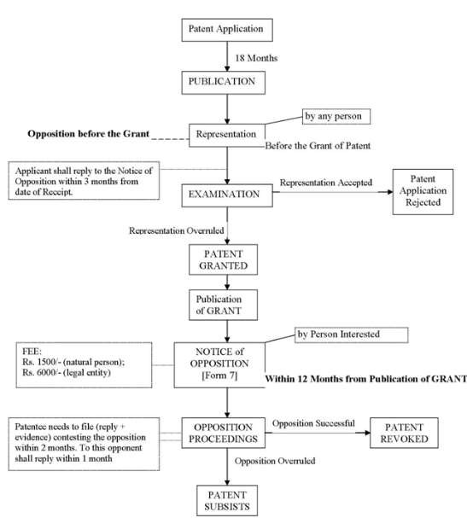
37

Slide 111
E. GRANT:
38
If the application satisfies all the requirements of the patent act, the application is said to be in order for grant.
A granted patent gives the patent holder the exclusive right to make, use, sell, offer for sale and import the product or use the process.

Slide 112
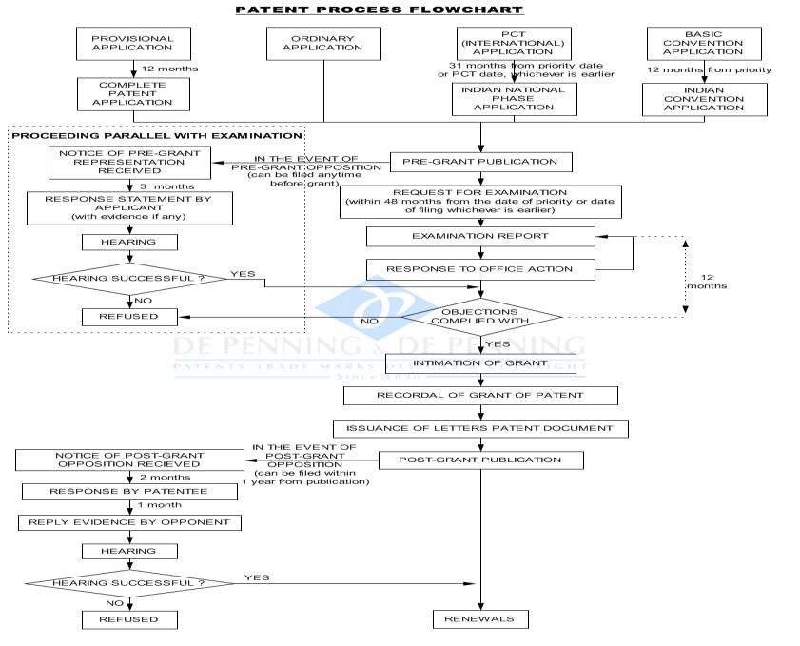
39

Slide 113
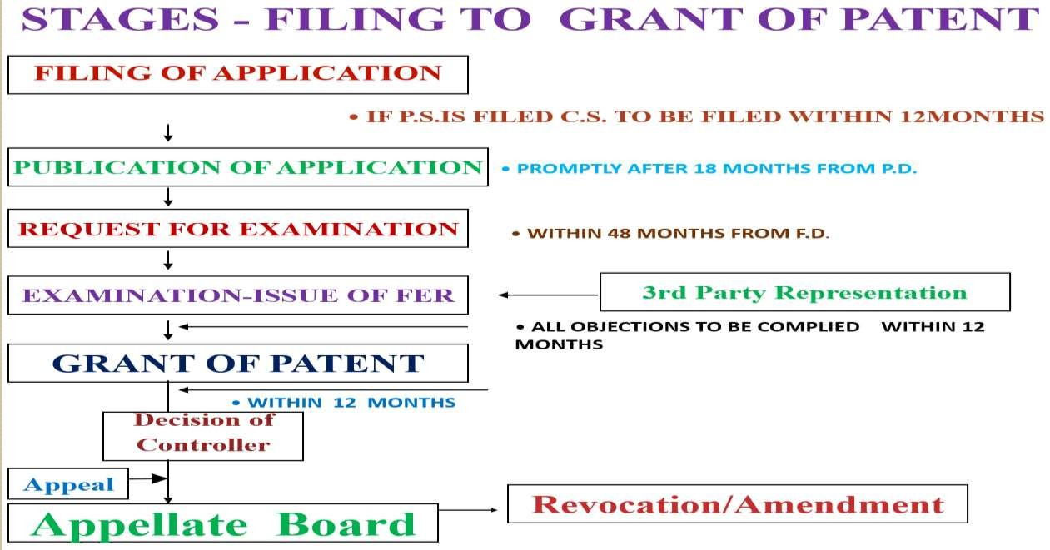
40

Slide 114
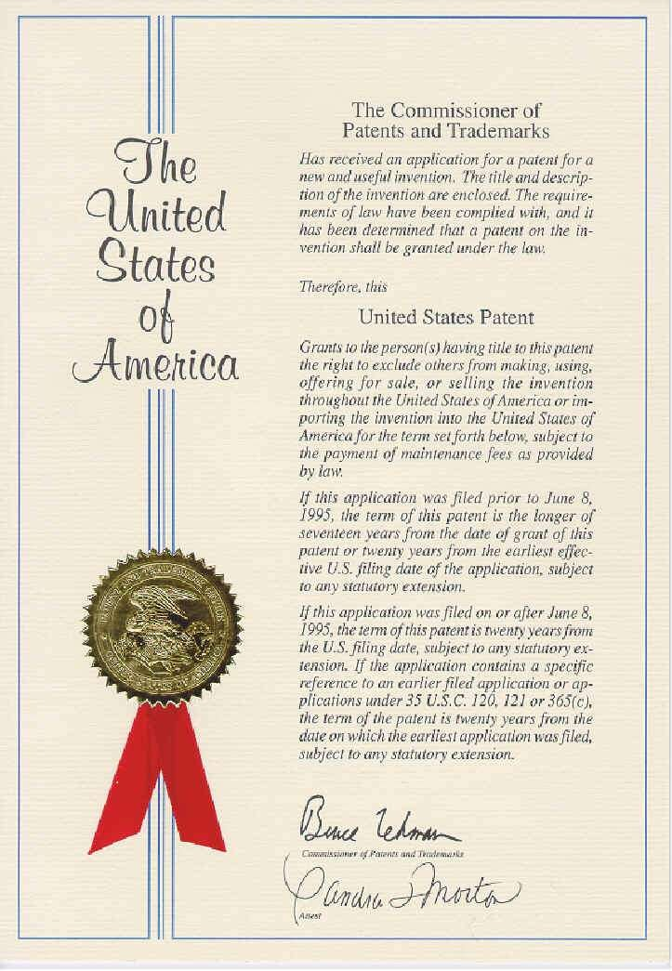
Certificate of PATENT

Slide 115
